Slide 1
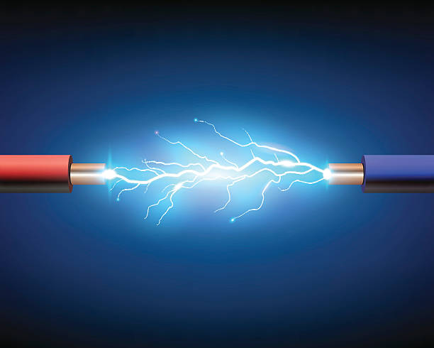
ENERGY GENERATION USING PIEZOELECTRIC TECHNOLOGY
VELAMMAL ENGINEERING COLLEGE, CHENNAI- 66
TEAM MEMBERS:
Madhumitha A
Keerthiga S
Sivasangari S
Sakthi Sri E

Slide 2

CONTENTS
Abstract
Objective
Methodology
Sensors used
Architecture
Result and proof of concept
Conclusion

Slide 3

ABSTRACT
Our country is prone to a shortage of electricity and severe power cuts. Day by day, the population is increasing all over the world. Power cuts are often occurring in various regions. So as the need for electricity is also increasing. By using piezoelectric technology, we can able to transform mechanical stress into electricity. Due to this emerging technology, we can able to achieve the energy that is used for minimal purposes. In this context, the development of an automated energy-generating device using piezoelectric technology which is used for charging mobile phones will be an efficient solution.

Slide 4
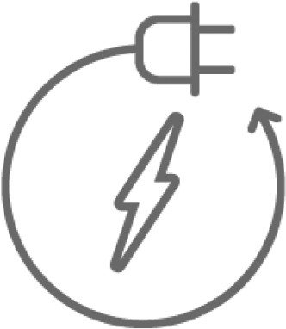
OBJECTIVE
The main motto of this project is to utilize the waste energy efficiently.
To generate the energy we are developing automated hammering device
The purpose of this project is to provide a solid solution for the generation of reliable amount of power by using the conversion of mechanical energy into electrical energy
It makes user to charge their mobile phones in an efficient manner.

Slide 5
METHODOLOGY
The collection of elements utilized in this circuit is LCD, DC motors, and pulleys. The pulley is used to leverage the hitting tool up and down by using the DC motor.
The piezoelectric sensors are mounted above the platform and the hitting device is done by using DC motors and a pulley.
The hitting device is made in such a way as to generate a large amount of voltage. In a piezoelectric sensor, there is a cathode and anode due to the pressure applied in the sensors, generates electric charges.

Slide 6
METHODOLOGY
The voltage that is generated from the piezoelectric sensors is given to the voltage sensor. The voltage sensor detects the AC voltage.
The sensor is connected to the micro controller. Here the micro controller is Arduino UNO. The micro controller controls the flow of voltage within the circuitry.
Later, the acquired voltage is displayed on the LCD. The charging port is the thing that is used to charge mobile phones or other electronic gadgets.

Slide 7
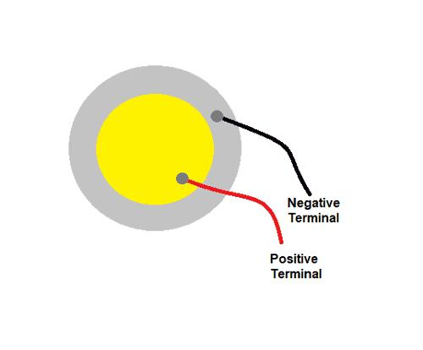
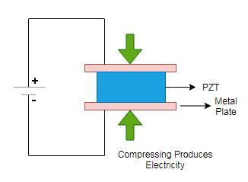
SENSORS USED
PIEZOELECTRIC SENSORS:
A Piezoelectric Sensor requires no external voltage or current source, they are able to generate an output signal from the strain applied.
It contains a cathode and anode. It’s lifetime is around 12 years.
It has high strength and wide frequency range which makes the piezo sensor more efficient.

Slide 8
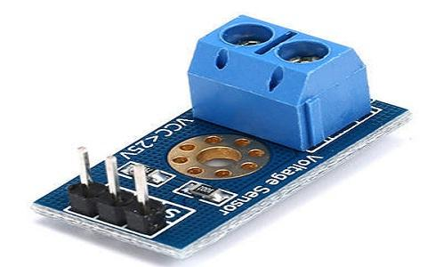
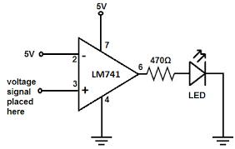
SENSORS USED
VOLTAGE SENSORS:
This sensor is used to monitor, compute, and determine the voltage supply. The AC and DC voltage level can be determined by this sensor.
This sensor's input can take the form of voltage, while its output can take the form of switches, analogue voltage signals, current signals, audio signals, etc.

Slide 9
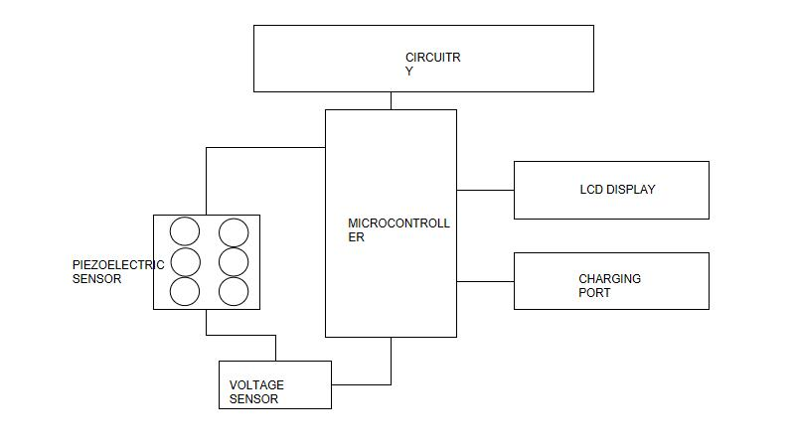
ARCHITECTURE

Slide 10

RESULT AND PROOF OF CONCEPT
WORKING MODEL

Slide 11
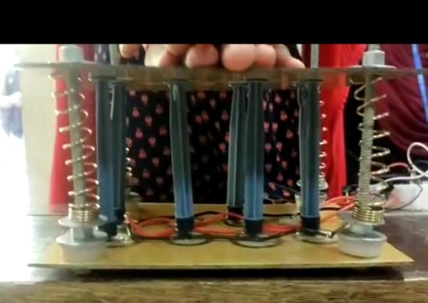
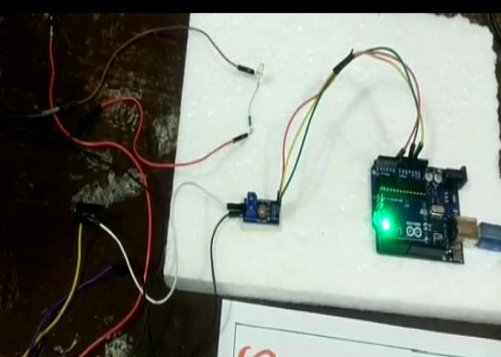
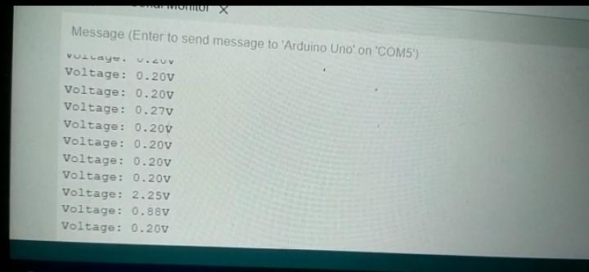
RESULT AND PROOF OF CONCEPT

Slide 12

RESULT AND PROOF OF CONCEPT

Slide 13
CONCLUSION
Thus we have developed the prototype of the device.
This device is the best solution to use the mechanical stress efficiently.
In future, we will develop the complete automated energy generating device.

Slide 14
THANK YOU !!

